Slide 1

Project Title: Netflix Dataset Analysis
Avinash Raj Anand
AICTE Internship Student Registration ID : STU68a5ea91c305a1755703953

Slide 2

PROBLEM STATEMENT
Netflix has become one of the most prominent global streaming platforms, continuously expanding its library with a mix of original productions and licensed content. However, with growing competition from platforms like Amazon Prime, Disney+, and regional OTT providers, Netflix must strategically analyze its content catalog to identify strengths, gaps, and opportunities.
The specific problem to be addressed in this project is 'Content Trends Analysis for Strategic Recommendations'. The aim is to uncover how Netflix’s content distribution (Movies vs. TV Shows, genres, and country contributions) has evolved over the years. This will enable the identification of key genres, audience preferences, and strategic insights into global content expansion.

Slide 3
Project Description
The project “Netflix Dataset Analysis” aims to explore and analyze a dataset of 7,789 records containing details of Movies and TV Shows on Netflix. The focus is on identifying content trends such as the evolution of Movies vs. TV Shows, popular and underrepresented genres, and country-wise contributions. By applying data analytics and visualization techniques, the study uncovers how Netflix’s catalog has evolved over time and provides strategic recommendations for content acquisition and production, helping Netflix strengthen its global presence in the highly competitive OTT industry.

Slide 4

WHO ARE THE END USERS?
Netflix Management & Strategy Teams – to use insights for decision-making on content acquisition, production, and expansion.
Content Creators & Producers – to understand trends in genres and audience preferences for aligning future productions.
Market Analysts & Researchers – to study OTT content distribution patterns and industry competition.
Students & Academics – as a case study for applying data analytics in real-world business scenarios.

Slide 5

Technology Used
Programming Language: Python
Libraries for Data Analysis & Cleaning: Pandas, NumPy
Data Visualization: Matplotlib, Seaborn, Plotly
Exploratory Data Analysis (EDA): Jupyter Notebook
Data Storage/Handling: CSV (Netflix dataset)
Optional (if you extend): Tableau/Power BI for dashboarding, Scikit-learn for trend prediction

Slide 6
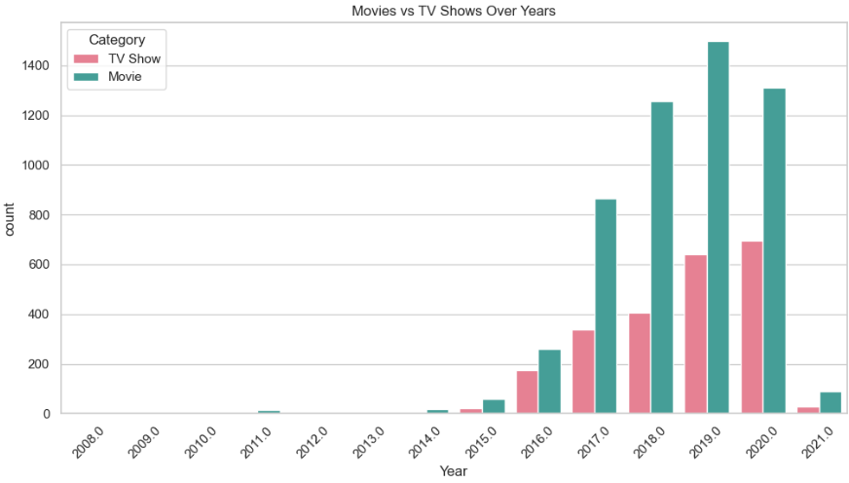
RESULTS1

Slide 7
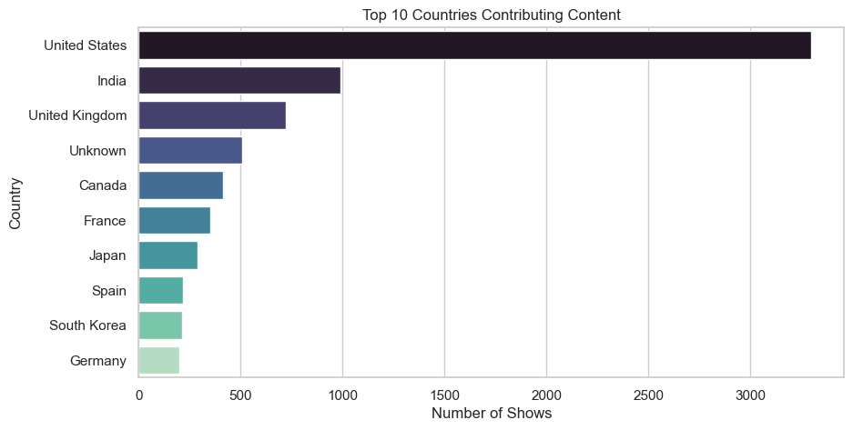
RESULTS2

Slide 8
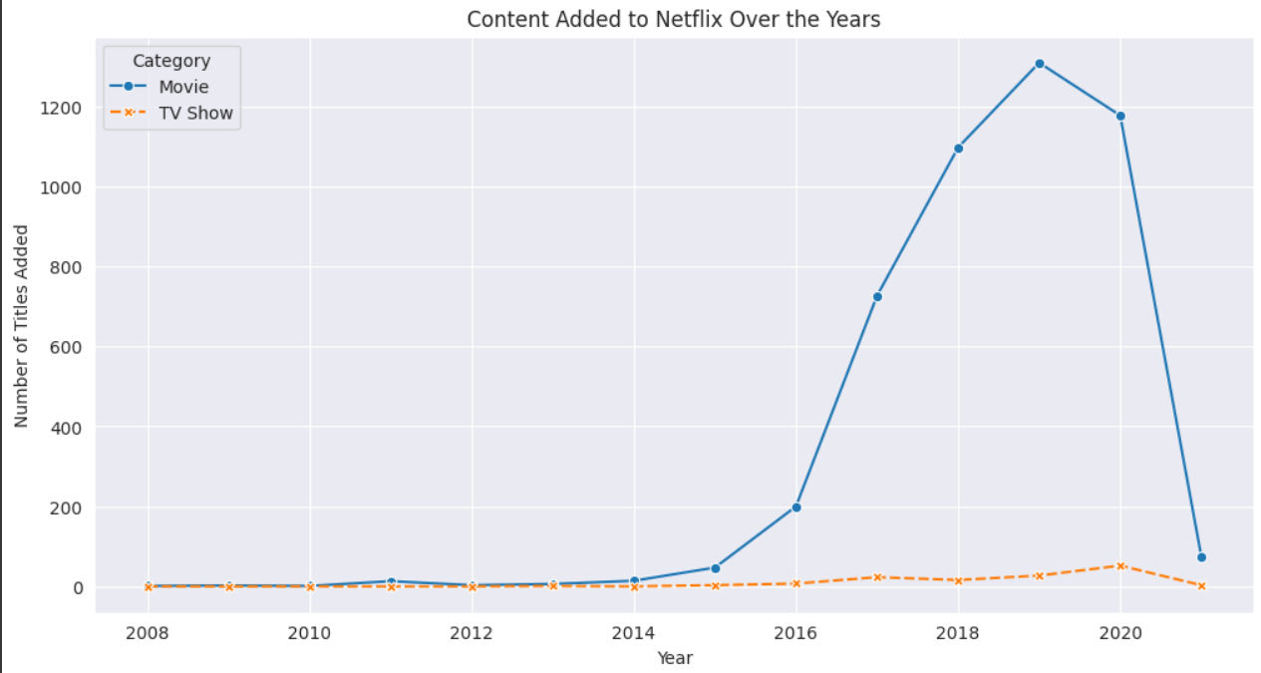
RESULTS3

Slide 9
GitHub repository
https://github.com/coder-avinash7/VOIS_AICTE_Oct2025_MajorProject_AvinashRajAnand.git

Slide 10
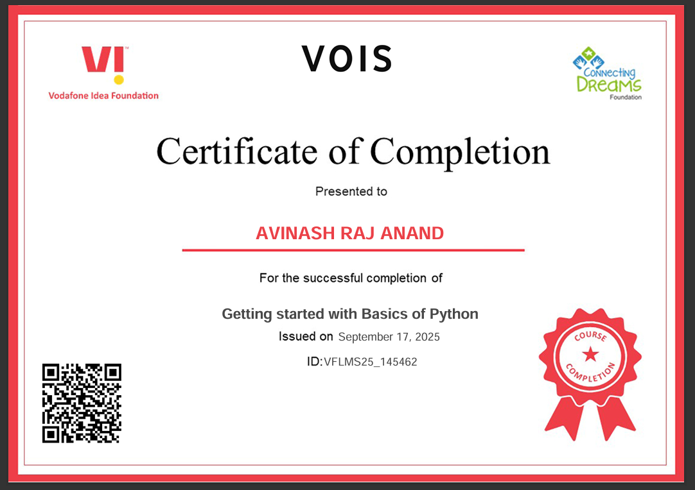
Getting started with Basics of Python Certificate

Slide 11
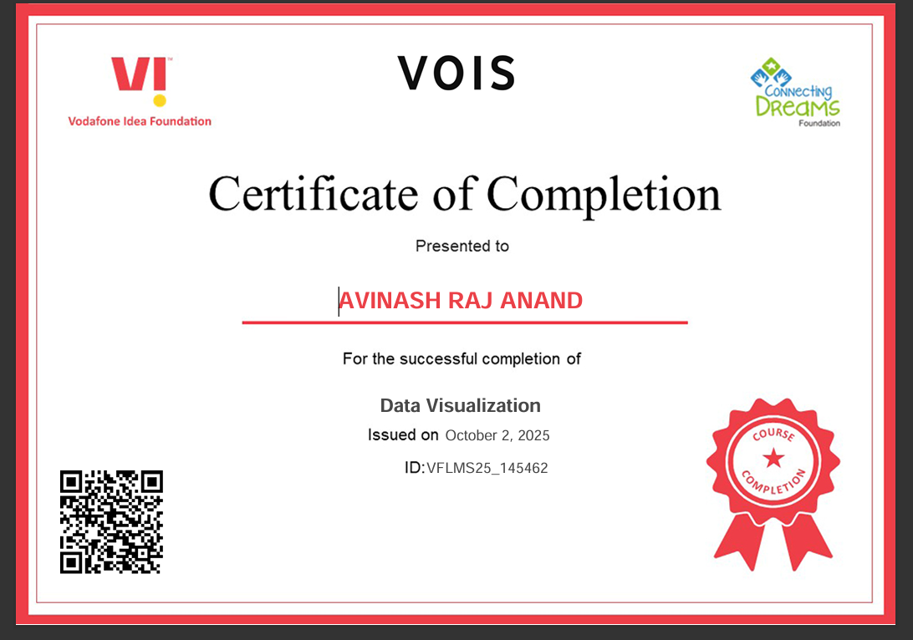
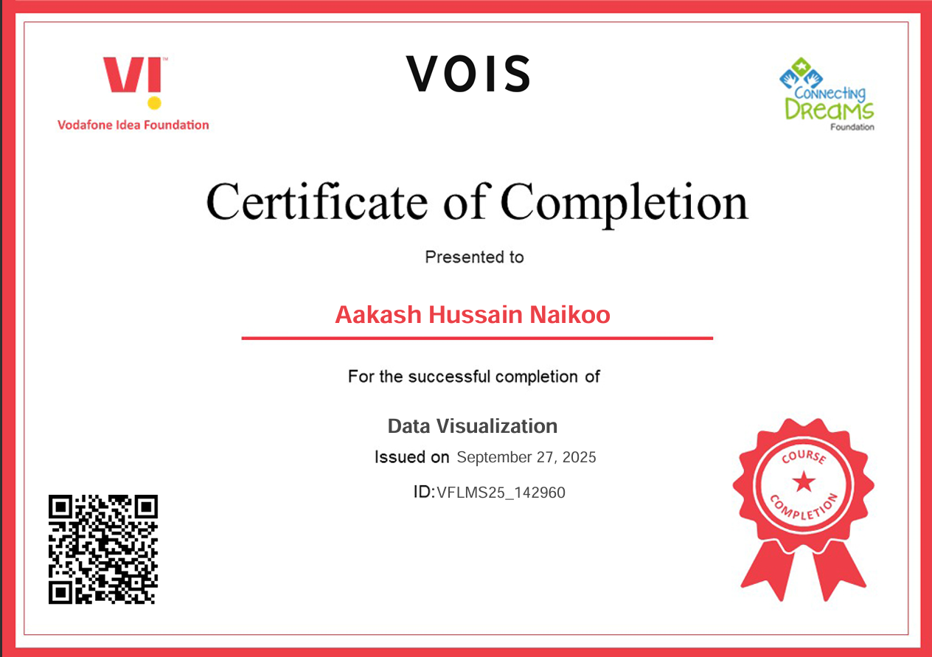
Data Visualization Certificate

Slide 12
THANK YOU
.
.

